Slide 1
App for the disabled
Name
Institution
Notes:
App for the disabled

Slide 2
Problem statement
In the society many people are disabled in many ways.
Many cannot speak, others cannot hear and others cannot move on their legs among many others forms.
Many of the people who cannot move on their own often get challenges accessing paths where their wheel chairs can move on (Hoisington, 2017).
The focus of this study is on the development of an app that will aid the disabled in locating the terrain as well as paths that they walk can use on their wheel chairs.
Notes:
In the society many people are disabled in many ways. Many cannot speak, others cannot hear and others cannot move on their legs among many others forms. Many of the people who cannot move on their own often get challenges accessing paths where their wheel chairs can move on. The focus of this study is on the development of an app that will aid the disabled in locating the terrain as well as paths that they walk can use on their wheel chairs.

Slide 3
Importance of the App
The new App will be important in making sure that the disabled can have good understanding of the paths to take before they leave home, work place or any other area they may have travelled to.
This will enable them to avoid routes where their wheel chairs cannot easily access.
They will also be able to identify vehicles and offices that facilitate wheel chair movement for the disabled
Notes:
The new App will be important in making sure that the disabled can have good understanding of the paths to take before they leave home, work place or any other area they may have travelled to. This will enable them to avoid routes where their wheel chairs cannot easily access. They will also be able to identify vehicles and offices that facilitate wheel chair movement for the disabled

Slide 4
Evidence
According to the American with Disabilities Act, and other disability acts in countries, building facilities, transport vehicles and the road development authority is expected to ensure that the disabled have access to safe paths.
15% of the world lives with a form of disability and 2% experience extreme malfunction (WHO, 2017).
. Each year, 1.5 million people die globally annually from accidents and many are left unable to walk without wheelchairs(WHO, 2017).
Notes:
According to the American with Disabilities Act, and other disability acts in countries, building facilities, transport vehicles and the road development authority is expected to ensure that the disabled have access to safe paths. 15% of the world lives with a form of disability and 2% experience extreme malfunction. Each year, 1.5 million people die globally annually from accidents and many are left unable to walk without wheelchairs

Slide 5
App description
The new App will aid the disabled in identification of the terrain of various paths
It will be linked with Google map which indicates direction while at the same time documenting structure texture and accessibility of roads by the disabled (Macs Adventure, 2018).
It will also document buildings and public transport means that are accessible by people with difficulties walking.
It will display as well as record tracks.
Notes:
The new App will aid the disabled in identification of the terrain of various paths, it will be linked with Google map which indicates direction while at the same time documenting structure texture and accessibility of roads by the disabled. It will also document buildings and public transport means that are accessible by people with difficulties walking. It will display as well as record tracks.

Slide 6
App description
The App will be accessible everywhere and will not be dependent on the network signal as it will be downloadable on the phone
Customers will choose maps according to their most favorite areas (Marcus, & Wang, 2017).
The app will be accessible through smart phones
All of the users are thus expected to have smart phones
Notes:
The App will be accessible everywhere and will not be dependent on the network signal as it will be downloadable on the phone
Customers will choose maps according to their most favorite areas
The app will be accessible through smart phones
All of the users are thus expected to have smart phones

Slide 7
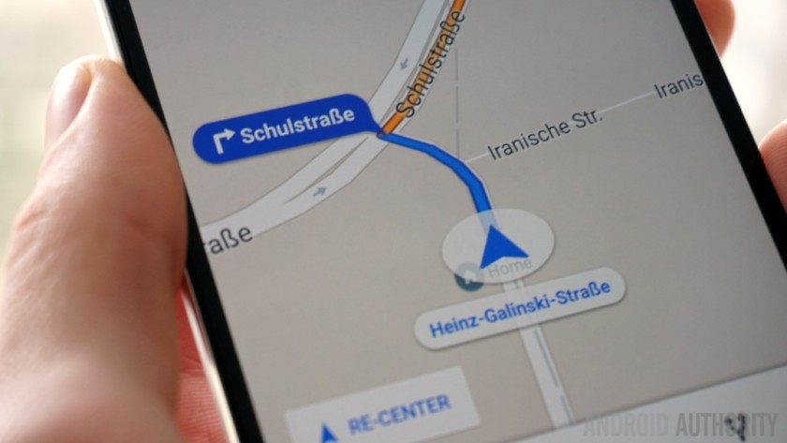
App navigation
Notes:
As indicated above the new application will be display direction on mobile phone

Slide 8
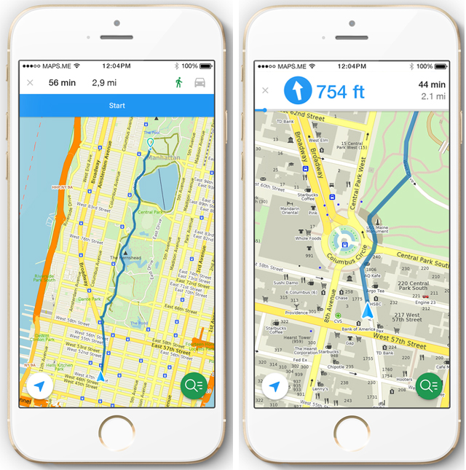
App navigation
Notes:
An aerial overview of the direction will equally be provided

Slide 9
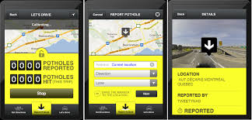
App navigation
Notes:
Road texture and structure will be provided as indicated in the above diagram (Home technology Montreal 2018).

Slide 10
Target market
In the area of marketing, target market refers to identified customer base where the individuals have homogeneous needs.
The target market should be economically viable.
In this case, the target market will be the people who cannot walk on their feet even though they can see. Such people rely on wheel chairs.
As a result, they need access to smooth roads, buildings as well as transport facilities that accommodate their needs
Notes:
In the area of marketing, target market refers to identified customer base where the individuals have homogeneous needs. The target market should be economically viable. In this case, the target market will be the people who cannot walk on their feet even though they can see. Such people rely on wheel chairs. As a result, they need access to smooth roads, buildings as well as transport facilities that accommodate their needs

Slide 11
Competition
Currently, there are multiple applications used in mapping direction. Some of these Apps includes abvio walkmetre, black country navigator, charity miles, Komoot, Medal routes App and type and walk app among many others.
The main benefit of this new app is that it is customized to the needs of the disabled. Most of them are not reliant on networks as they are downloadable to the phone
Other potential rivals are likely to emerge in the market
Deomgrapohic and geographical targeting wll be employed
The App will target the disabledUS and UK citizens before being enrolled elsewhere
Notes:
Currently, there are multiple applications used in mapping direction. Some of these Apps includes abvio walkmetre, black country navigator, charity miles, Komoot, Medal routes App and type and walk app among many others.
The main benefit of this new app is that it is customized to the needs of the disabled. Most of them are not reliant on networks as they are downloadable to the phone

Slide 12
App development team
The team will include ten computer engineers with skills in app development and coding.
Some of the key coding language that they will require is python.
The team will ensure that the application is tested before being launched.
They will ensure effective functionality of the App as well as easy to navigate interface (Kurosu, 2017).
Notes:
The team will include ten computer engineers with skills in app development and coding. Some of the key coding language that they will require is python. The team will ensure that the application is tested before being launched. They wilkl ensure effective functionality of the App as well as easy to navigate interface

Slide 13
Remuneration of App development team
Effective reward management will ensure that the employee are motivated.
The reward will be contract based.
The team will be awarded $ 10,000 per month per individual for a period of six months.
During this period, it is expected the App will be complete and fully implemented.
Six of the team members will be retained for six extra months to aid in program control and monitoring.
They will be repaid the same amount per month (Hoisington, 2017).
Notes:
Effective reward management will ensure that the employee are motivated. The reward will be contract based. The team will be awarded $ 10,000 per month per individual for a period of six months. During this period, it is expected the App will be complete and fully implemented. Six of the team members will be retained for six extra months to aid in program control and monitoring. They will be repaid the same amount per month

Slide 14
Conclusion
Based on the above presentation it is evident that the App will aid the disabled in identifying paths.
It will also aid them in identifying buildings and public transport that aids wheel chair movement.
From the study, it is clear that many people are disabled annually as a result of accidents.
The new app will thus make their lives better
Notes:
Based on the above presentation it is evident that the App will aid the disabled in identifying paths. It will also aid them in identifying buildings and public transport that aids wheel chair movement. From the study, it is clear that many people are disabled annually as a result of accidents. The new app will thus make their lives better

Slide 15
References
Hoisington, c. (2017). Microsoft visual basic windows web windows store
&database apps. s.l.: cengage learning.
Home technology Montreal (2018). Pothole app. Retrieved from
http://www.hometechmtl.com/pothole-season-theres-an-app-for-that/
Kurosu, M. (2017). Human-Computer Interaction. Interaction Contexts: 19th
International Conference, HCI International 2017, Vancouver, BC, Canada,
July 9-14, 2017, Proceedings, Part II. McGraw Hills
Marcus, A., & Wang, W. (2017). Design, User Experience, and Usability: Designing
Pleasurable Experiences: 6th International Conference, DUXU 2017, Held as
Part of HCI International 2017, Vancouver, BC, Canada, July 9-14, 2017,
Proceedings, Part II. New York: McGraw Hills
Macs Adventure (2018). 9 great phone apps for walkers and hikers. Retrieved from
https://www.macsadventure.com/walking-holidays/9-great-phone-apps-for-
walkers-and-hikers/
WHO (2017). Disability on disability. Retrieved from
http://www.who.int/disabilities/world_report/2011/report/en/
Notes:
Hoisington, c. (2017). Microsoft visual basic windows web windows store
&database apps. s.l.: cengage learning.
Home technology Montreal (2018). Pothole app. Retrieved from
http://www.hometechmtl.com/pothole-season-theres-an-app-for-that/
Kurosu, M. (2017). Human-Computer Interaction. Interaction Contexts: 19th
International Conference, HCI International 2017, Vancouver, BC, Canada,
July 9-14, 2017, Proceedings, Part II. McGraw Hills
Marcus, A., & Wang, W. (2017). Design, User Experience, and Usability: Designing
Pleasurable Experiences: 6th International Conference, DUXU 2017, Held as
Part of HCI International 2017, Vancouver, BC, Canada, July 9-14, 2017,
Proceedings, Part II. New York: McGraw Hills
Macs Adventure (2018). 9 great phone apps for walkers and hikers. Retrieved from
https://www.macsadventure.com/walking-holidays/9-great-phone-apps-for-
walkers-and-hikers/
WHO (2017). Disability on disability. Retrieved from
http://www.who.int/disabilities/world_report/2011/report/en/

